Slide 1
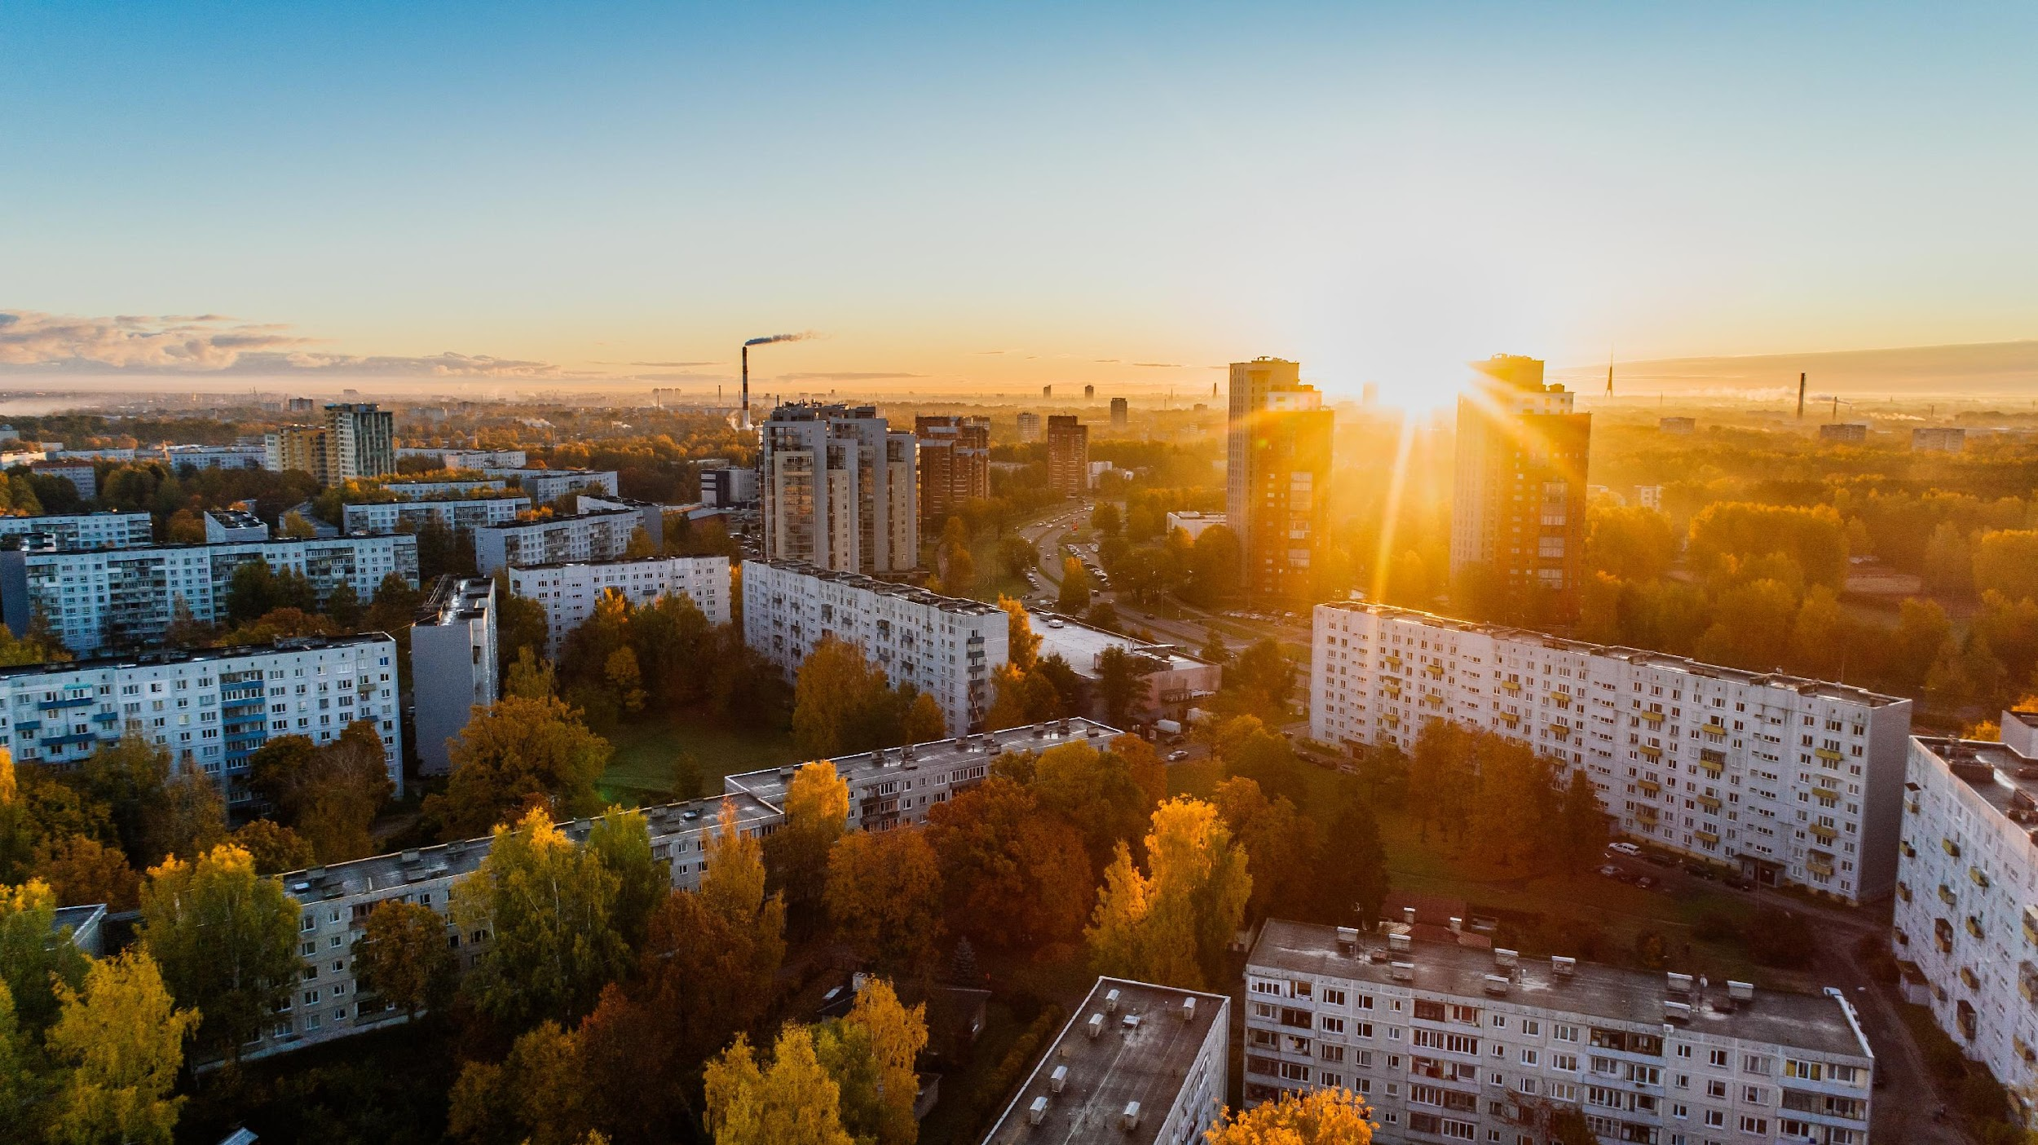
DSO 597 Project
Data Driven Real Estate Decisions to Maximize ROI
Team 1: Antonius Raharja, Edwin Wu, Kyunghwan Kim, Rizabek Zhumkenov, Vania Ibrahim, Yang Song
Notes:
Slides 1-3 = Edwin
Slides 4-7 = Yang
Slides 8-9 = Antonius
Slides 10-12 = Vania
Slides 13-19 = Edwin & Riza

Slide 2

Outline
1
Approach to Business Problem
2
Data Cleaning Process
3
Random Forest Classifier Model
4
Business Insights
5
Visualization

Slide 3

Approach to Business Problem
2
3
4
Features correlated to Rent/Square Feet
Build Models/ Visualization
Present Insights
We extracted and analyzed possible features that would affect rent/square feet price
We built predictive models and visualizations based on the final data
We will be presenting our results & business insights gained towards the end of our presentation
Research & Analyze Available Data
1
Based on the Yardi property/Census data
Notes:
Property Data / ACS Census data
Extracted and Analyzed Features affecting rent/square feet price
Random forest modeling by splitting our data into training and test data. And we would focus our visualizations and selections based on our testing data
Presenting census tracts within the recommended cities we have selected

Slide 4
Data Preparation
We performed in-depth analysis and extensive preparation of the Yardi and other datasets prior to building the model
Combine Regional Property Data
We extracted and combined all the Yardi property data together to perform our evaluation and analysis
Calculate Property Age
How old the current property is based on the completion date
Added # of Competitors
Utilized the # of unfinished properties within a census tract to be future competitor numbers
Create Unique Census Tract Identifier
Combined state + county + census tract code
Built a Distance Model
Find the # of Starbucks & Target within reasonable distance of a property
Incorporate US Census Data
Over 30 columns included as variables in our analysis
Remove N/As, 0s, Unused Columns
We dropped columns with extensive N/A/ 0 values and columns that are not contributing to the dataset
By performing the procedures above, we are prepared a complete and accurate data for analysis
Notes:
Hwan

Slide 5
Detailed Variables (Non-Census Data)
Property Characteristics
Dependent Variable
Rent / Square Feet
PROPERTY_UNITS * PROPERTY_CURRENT_RENT
PROPERTY_SQFT
Independent Variables
Competitors
# of incomplete properties (e.g. under construction) within the census tract
Age of Property
In number of days =
1/31/2022 - PROPERTY_COMPLETED
Starbucks Nearby
# of Starbucks within 1 mile radius by subtracting the longitude/latitude between 1 Starbucks and 1 property
Targets Nearby
# of Target within 10 mile radius by subtracting the longitude/latitude between 1 Target and 1 property
Property Acres
SIze of property land in acres
Notes:
Yes

Slide 6


Demographic Data
Accessed the US Census Demographic data (ACS5- 19) using Python API code
Researched and selected variables of interest
Filtered data by states of interest
Sourced data on a tract level, and when tract level data was unavailable, imputed from county/state data using mean values
Merged with original dataset with the Non-Census variables
Notes:
YS

Slide 7
US Census Demographic Variables
Education
Grouped by < high school, high school, some college, bachelor’s, grad degree in %
Women and Births
Women aged 15-50 who had a birth in the last 12 months [insert year] as a % of total population
Household Income
Total, In USD
Occupied/Vacant Units
% Occupied Units
Median Gross Rent
Monthly, in USD
Travel Time to Work
% of residents in various time ranges
Total Population
Per tract
Notes:
YS

Slide 8

Random Forest Model
Predicting Rent Per Sq Feet of each property
1
2
12,000 training data, 12,000 test data
3
Run the model on all variables
4
Achieved Mean absolute error of 0.19
50%
Training Data
50%
Test Data
86.42%
Prediction Accuracy

Slide 9
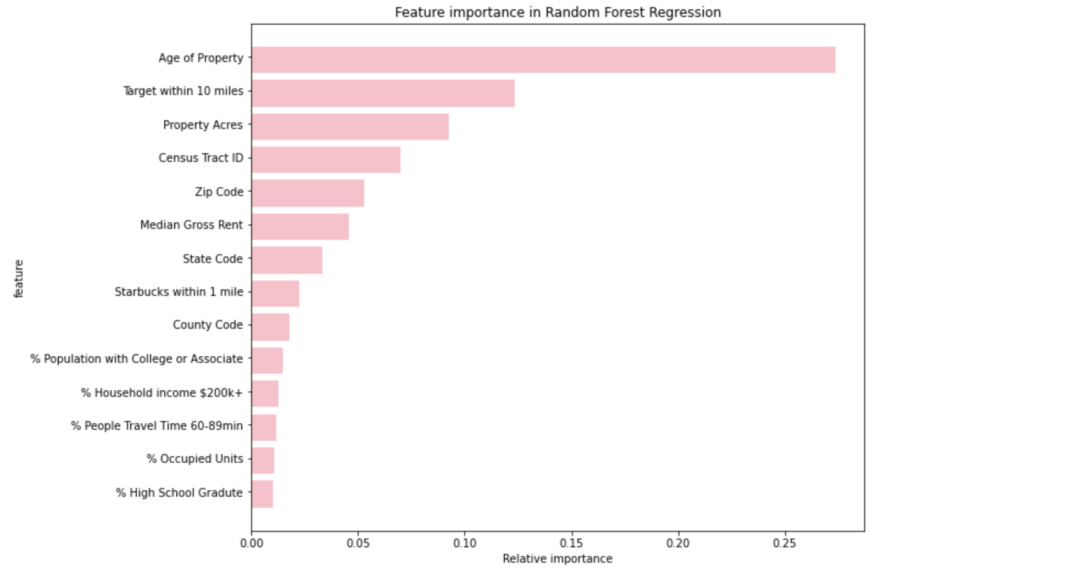
Feature importance
Variables Above 1% Significant to Model

Slide 10
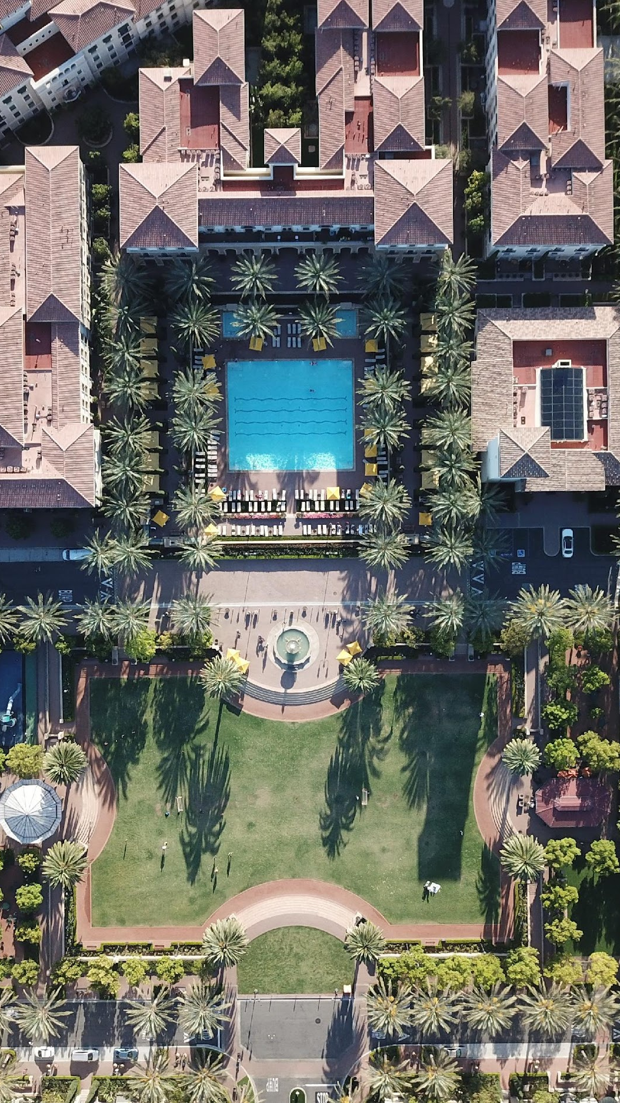
Valuation of Predicted vs Actual
Predicted - Actual Rent per Square Feet
Actual Rent per Square Feet
100
% Difference =
X
If Difference > 10%, classify as 1 (considered Undervalued), else 0

Slide 11
Valuation of Predicted vs Actual
Group By Census Tract ID
Total # of Undervalued Properties
Total Properties
% of Undervalued Properties within a Census Tract
(Labelled “Index”)
=
Filter:
Total Properties > 4
&
Index > 0.5
13 Census Tracts with over 50% undervalued properties

Slide 12
Initial Findings
# | census_tract_id | undervalued | total | index
1 | 13121011310 | 5 | 6 | 0.833333
2 | 32019002505 | 4 | 5 | 0.8
3 | 4013319104 | 4 | 5 | 0.8
4 | 48439102000 | 4 | 5 | 0.8
5 | 48113002100 | 4 | 6 | 0.666667
6 | 48201410601 | 5 | 8 | 0.625
7 | 13051010806 | 3 | 5 | 0.6
8 | 13089021204 | 3 | 5 | 0.6
9 | 13245010203 | 3 | 5 | 0.6
10 | 22033003912 | 3 | 5 | 0.6
11 | 45045001807 | 3 | 5 | 0.6
12 | 48113003103 | 3 | 5 | 0.6
13 | 48167725600 | 3 | 5 | 0.6

Slide 13
Top 5 census tracts after the validation
№ | State | County | City | Zip code | Census tract | # of undervalued properties | total # of properties | Index
1 | TX | Galveston | Galveston | 77551 | 725600 | 3 | 5 | 0.6
2 | AZ | Maricopa | Tempe | 85282 | 319104 | 4 | 5 | 0.8
3 | SC | Greenville | Greenville | 29615 | 001807 | 3 | 5 | 0.6
4 | TX | Harris | Houston | 77002 | 410601 | 5 | 8 | 0.63
5 | GA | Chatham | Savannah | 31419 | 010806 | 3 | 5 | 0.6
Notes:
General / Economic:
Population growth (preferred: at least or equal to 20% since 2000)
Income growth (preferred: at least or equal to 30% since 2000)
Median house/condo ownership (preferred: at least or equal to 40% since 2000)
Median home price
Crime table (preferred: under 500)
Poverty level (preferred: under 20%)
Unemployment rate (neighborhood not more than 2% than the city)
Employer diversity (Number of major employer industries)
Racial diversity (preferred: 2 or more races with at least 25%)
Major LT institutions (preferred: i.e. military bases, higher education institutions, major medical facilities)
Regional infrastructure (i.e. airports, train stations, ports, etc.)
New home builds
Construction permits (in units or $, housing and multifamily)
Construction cost ($/sqft)

Slide 14
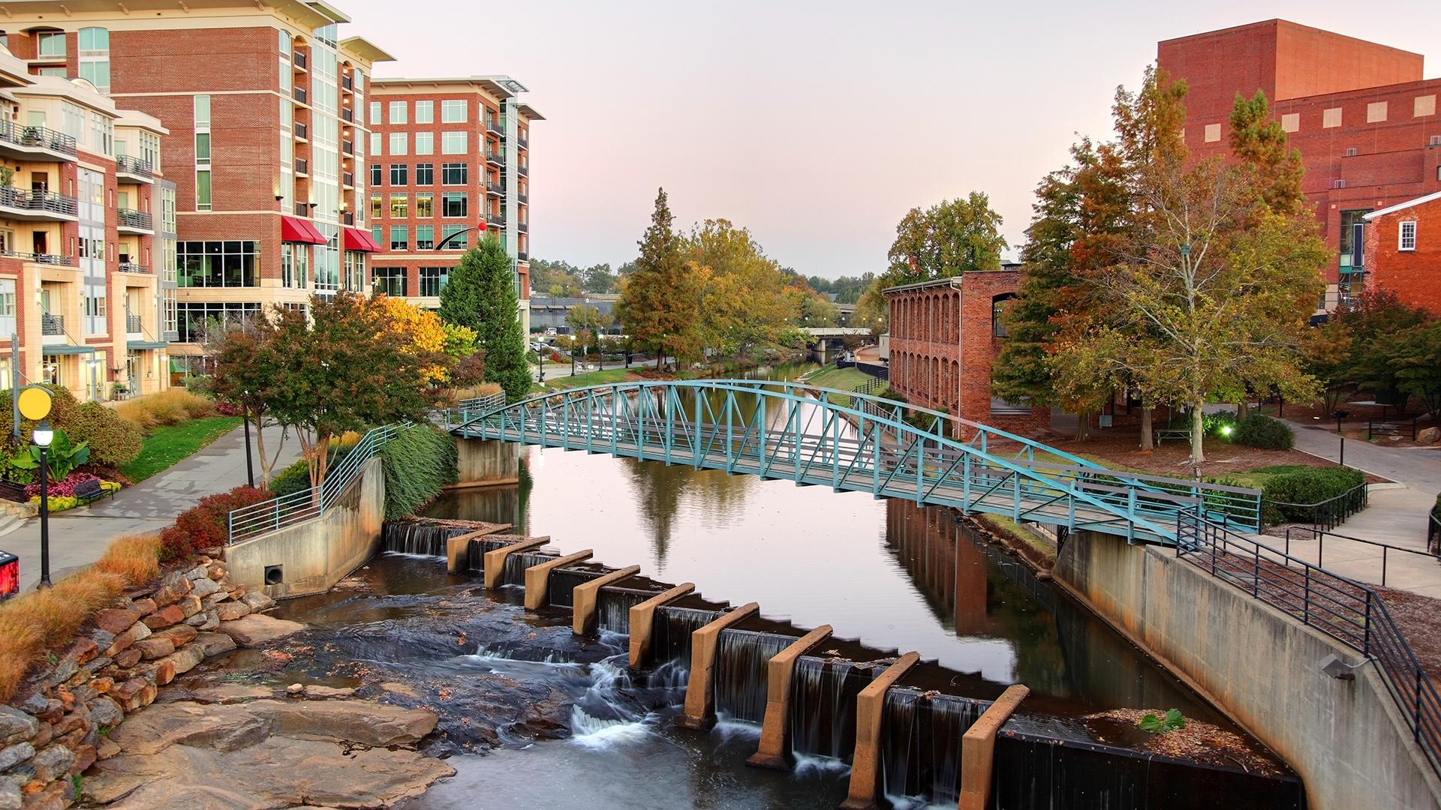
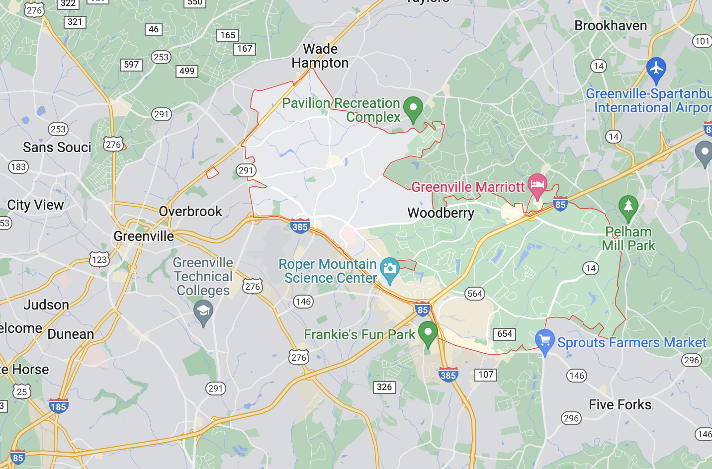
Census Tract ID: 45045001807
(Greenville, SC)
County: Greenville
Zip Code: 29615
# of undervalued properties: 3
total # of properties: 5
City Crime Rate (per 1000 residents): 49.43
City Poverty level: 13.4%
City Median Home price: $292,400
City 1-Year Income Growth: 5.67%
City Unemployment Rate: 3.5%
Median Home Sale Price % Increase YOY (City): 17.4%
Notes:
In between Atlanta and Charlotte 2-3 hours apart
March Madness tournament this past weekend… BMW museum

Slide 15
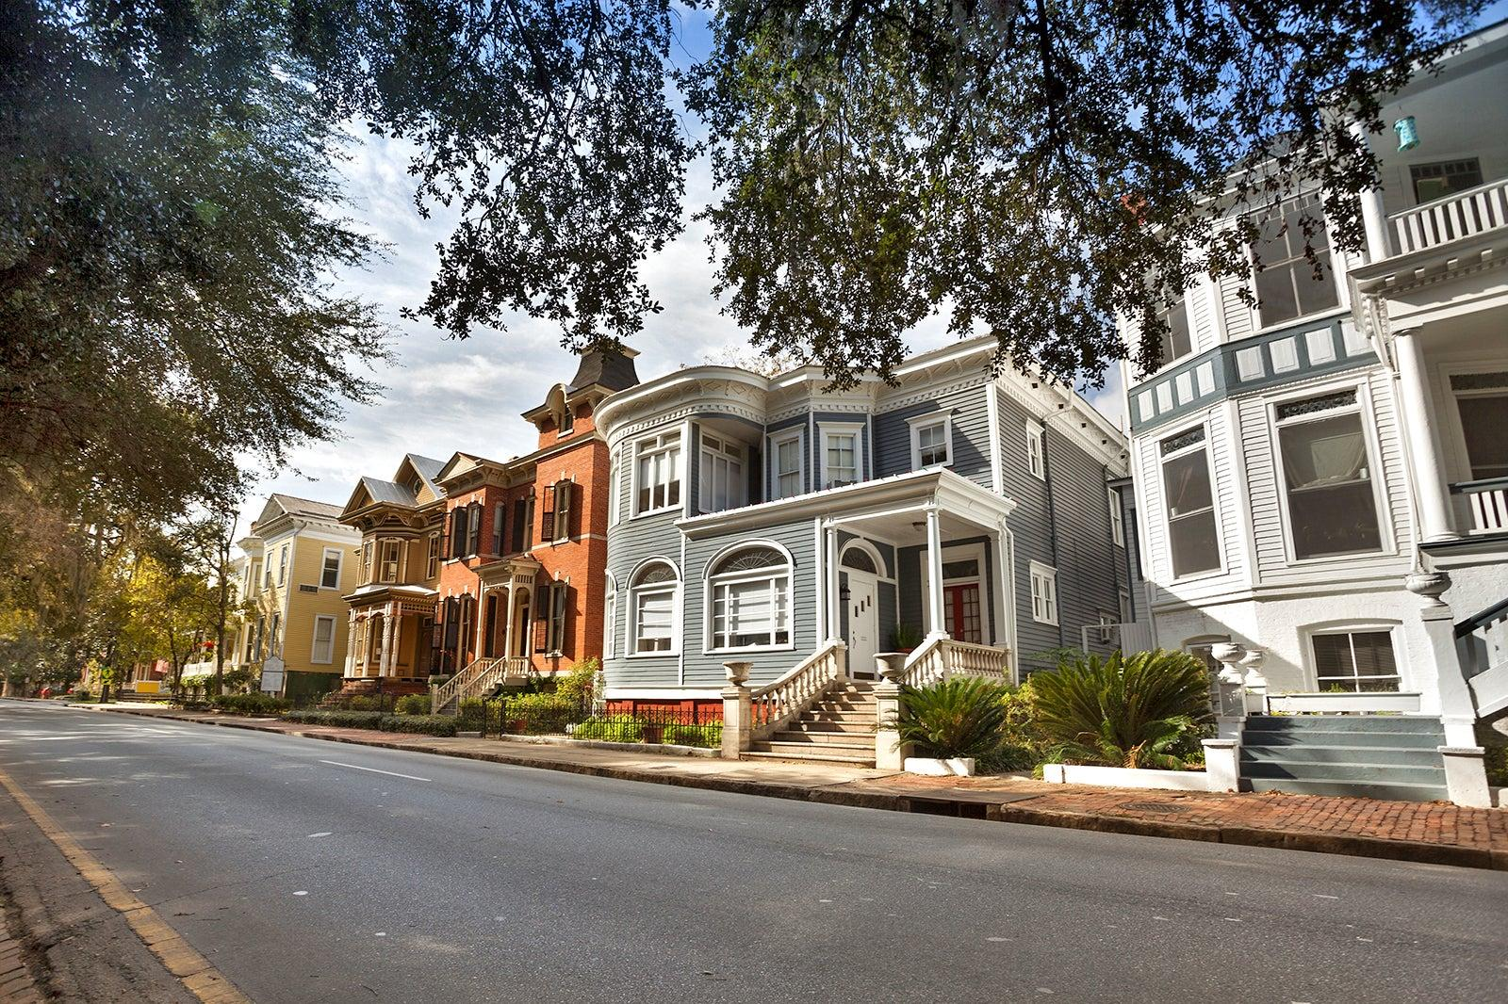
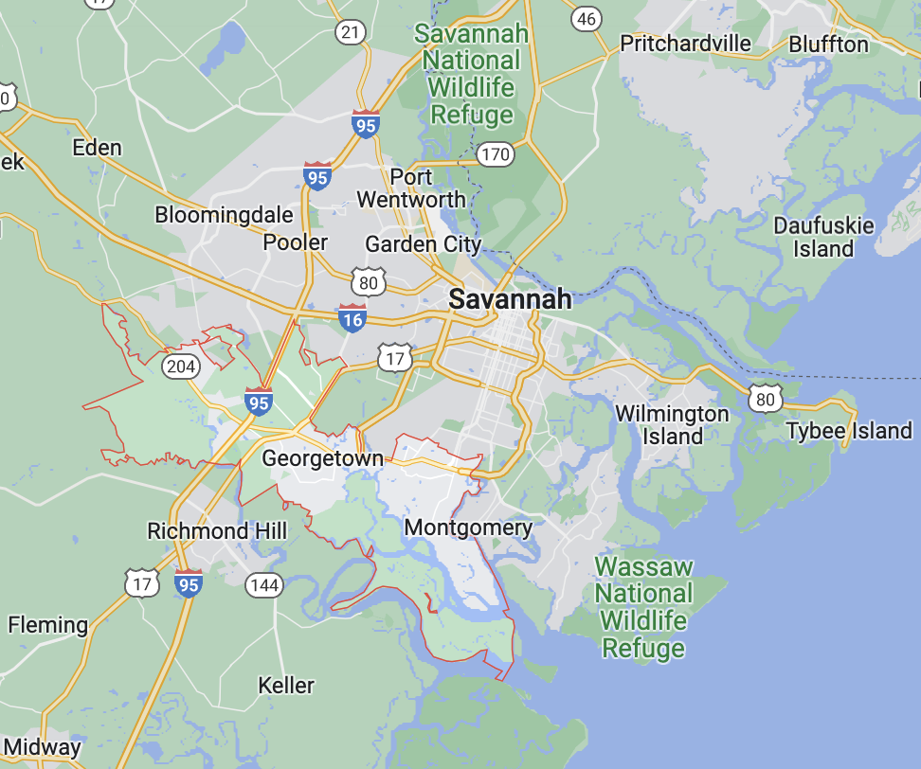
Census Tract ID: 13051010806
(Savannah, GA)
County: Chatham
Zip Code: 31419
Census Tract ID: 13051010806
# of undervalued properties: 3
total # of properties: 5
City Crime Rate (per 1000 residents): 24.64
City Poverty level: 13.7%
City Median Home price: $201,000
City 1-Year Income Growth: 3.77%
City Unemployment Rate: 4.2%
Median Home Sale Price % Increase YOY (City): 20.3%
Notes:
Coastal, oldest city in the state of Georgia

Slide 16

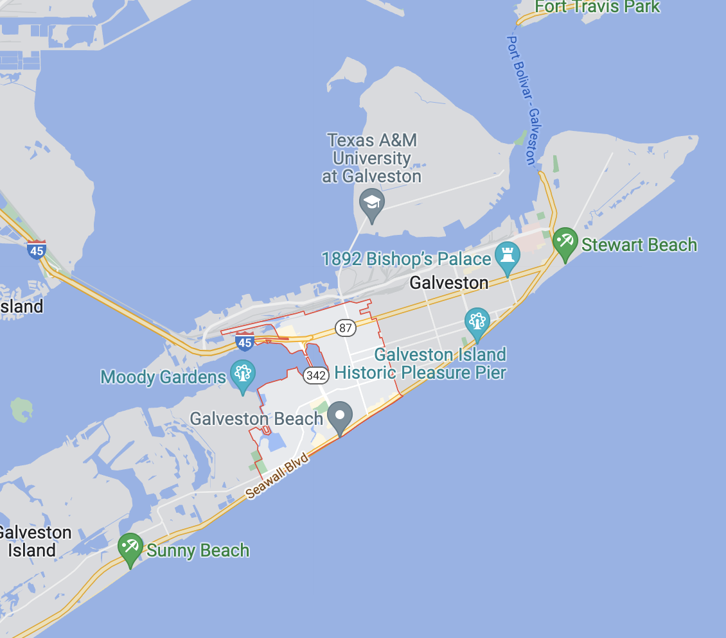
Census Tract ID: 48167725600
(Galveston, TX)
County: Galveston
Zip Code: 77551
# of undervalued properties: 3
total # of properties: 5
City Crime Rate (per 1000 residents): 37.64
City Poverty level: 19.90%:
City Median Home price: $182,800
City 1-Year Income Growth: 9.84%
City Unemployment Rate: 5.6%
Median Home Sale Price % Increase YOY (City): 14.6%
Notes:
From the training data, these census tracts within these cities we recommended from our testing data
Census tract within the city
General project overview
Poverty 20%

Slide 17
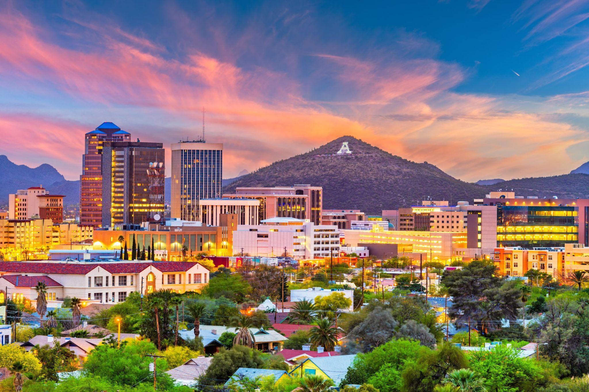
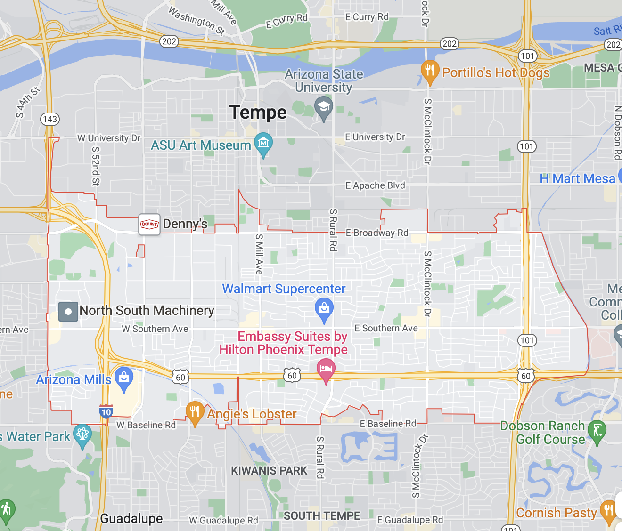
Census Tract ID:
4013319104
(Tempe, AZ)
County: Maricopa
Zip Code: 85282
# of undervalued properties: 4
total # of properties: 5
City Crime Rate (per 1000 residents): 48.19
City Poverty level: 19.8%
City Median Home price: $272,900
City 1-Year Income Growth: 6.98%
City Unemployment Rate: 2.7%
Median Home Sale Price % Increase YOY (City): 37.5%
Notes:
Tempe is a city in Arizona with a population of 187,454. Tempe is in Maricopa County and is one of the best places to live in Arizona. Living in Tempe offers residents an urban suburban mix feel and most residents rent their homes. In Tempe there are a lot of restaurants, coffee shops, and parks. Many young professionals live in Tempe and residents tend to have moderate political views. The public schools in Tempe are above average. https://www.niche.com/places-to-live/tempe-maricopa-az/
Right outside the Arizona State University campus 63000 undergraduate students , still within the phoenix metropolitan area.

Slide 18

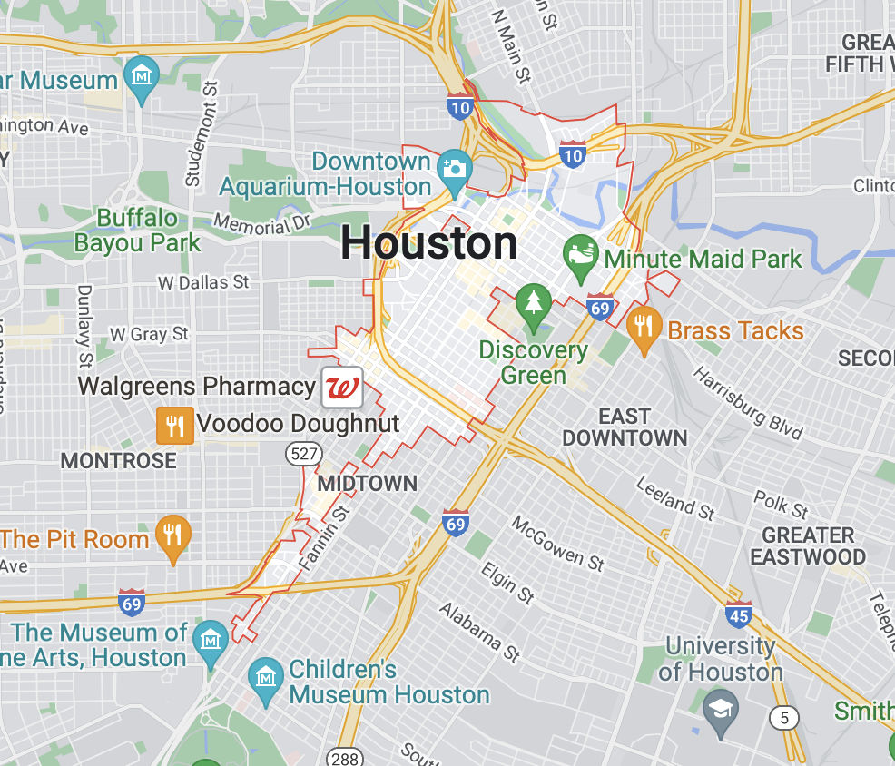
Census Tract ID: 48201410601
(Houston, TX)
“Home appraisals jump 21% in Harris County in 2022”
“4th Largest City in the US”
County: Harris
Zip Code: 77002
Census Tract ID: 48201410601
# of undervalued properties: 5
total # of properties: 8
City Crime Rate (per 1000 residents): 55.87
City Poverty level: 20.1%
City Median Home price: $195,800
City 1-Year Income Growth: 2.44%
City Unemployment Rate: 5.3%
Median Home Sale Price % Increase YOY (City): 17.2%
Notes:
4th largest city in the US, census tract particularly in the downtown area

Slide 19
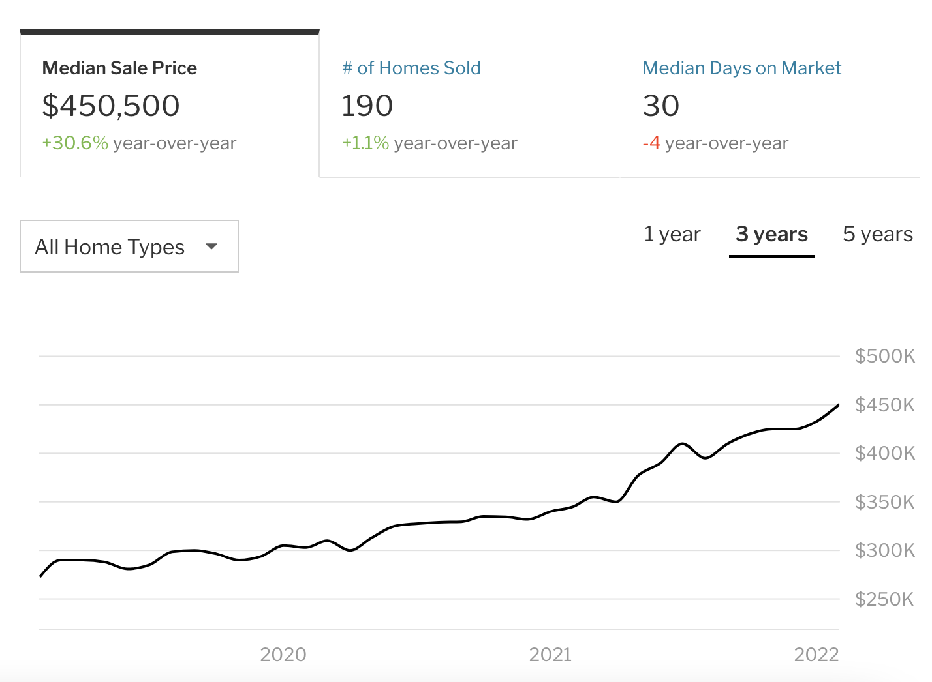
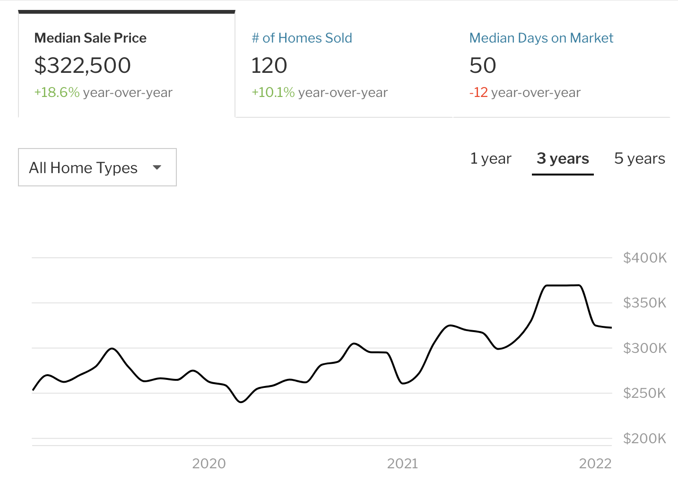
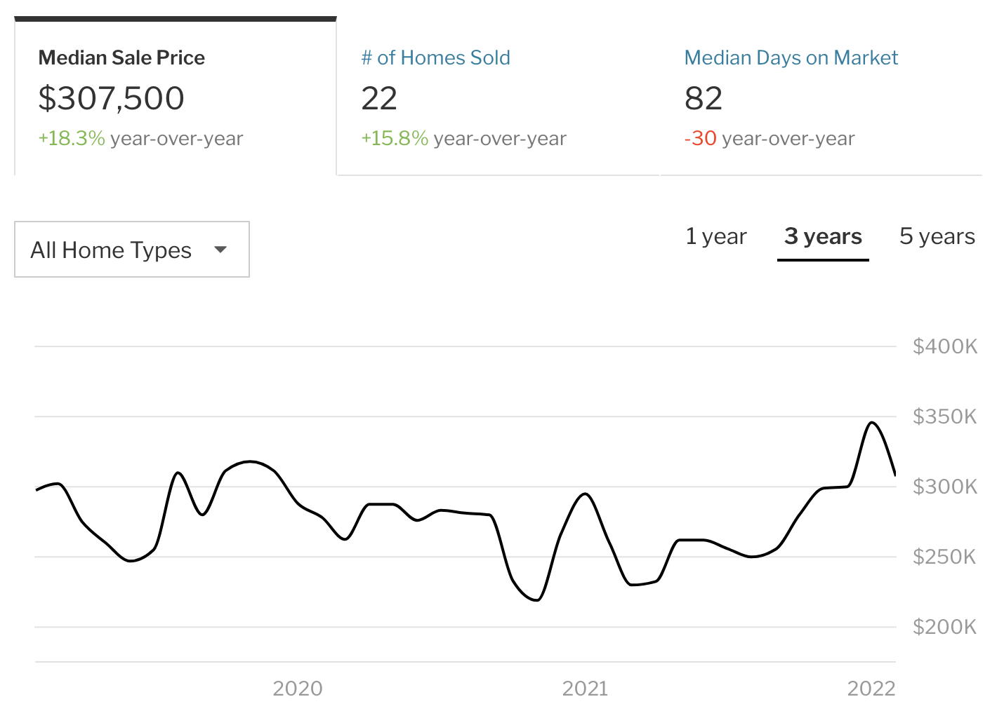
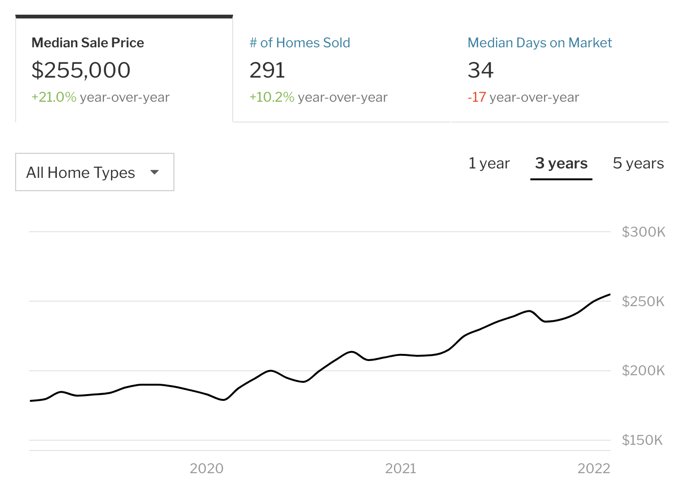
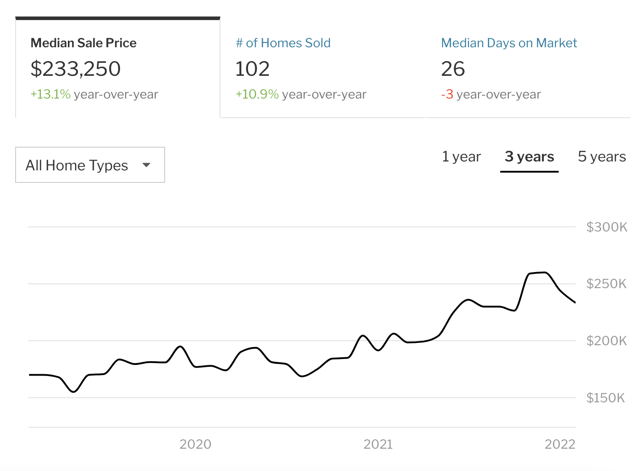
Greenville, SC
Tempe, AZ
Houston, TX
Savannah, GA
Galveston, TX

Slide 20
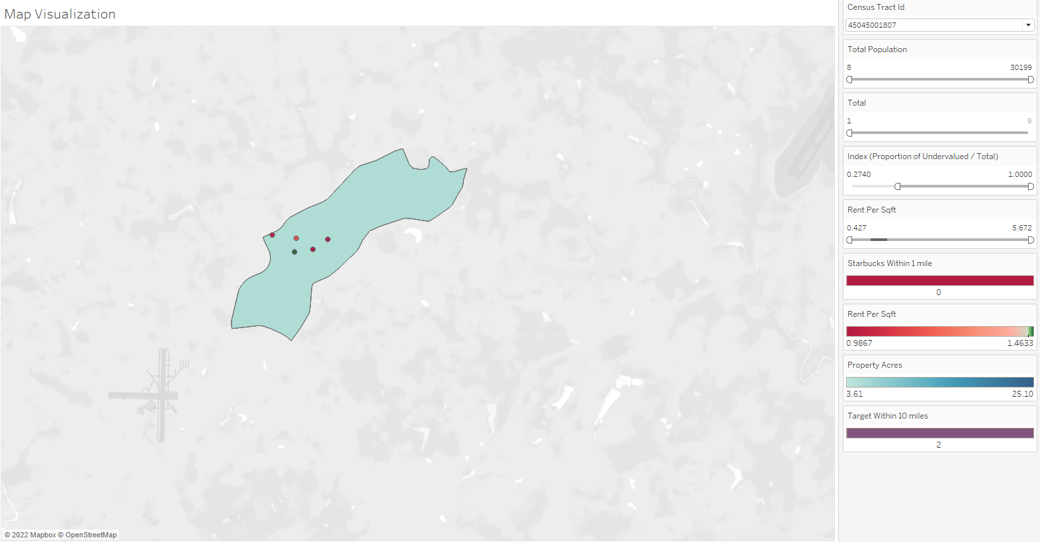
Tableau Visualization

Slide 21
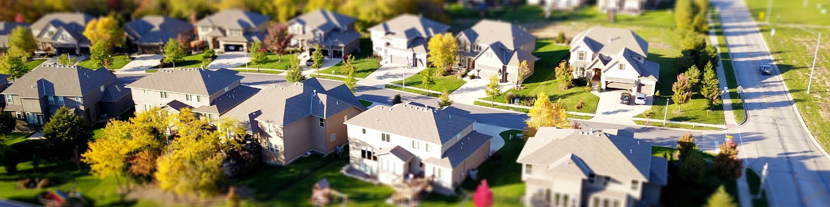
Conclusion
We recommend looking into/investing in the following census tract/city:
Census Tract: 48167725600 (Galveston, TX)
Census Tract: 4013319104 (Tempe, AZ)
Census Tract: 45045001807 (Greenville, SC)
Census Tract: 48201410601 (Houston, TX)
Census Tract: 13051010806 (Savannah, GA)

Slide 22
References
Neighborhood Scout (https://www.neighborhoodscout.com)
Data USA (https://datausa.io)
YCharts (https://ycharts.com)
RedFin Housing Market Trends (https://www.redfin.com/)

